Slide 1
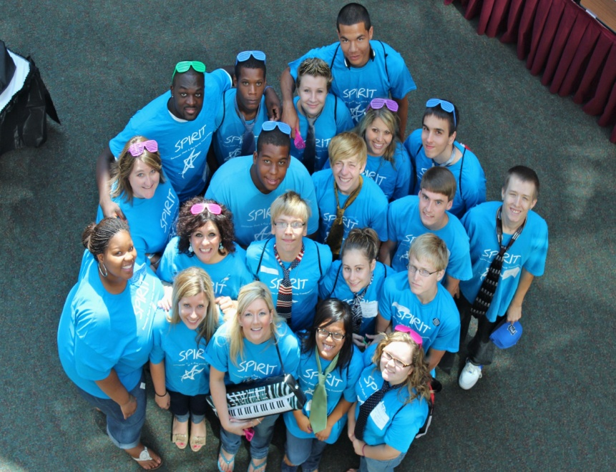
MYOI MACOMB
Building partnerships that help our youth succeed

Slide 2
MYOI Coordinator
Facilitates SPIRIT Youth Board meetings and events
Set up all MYOI participants with IDA bank accounts
Reserve professionals in the community to present trainings for the youth
Closed case services—YIT
Fundraising events

Slide 3
EDUCATION PLANNER
Help youth meet educational goals
Advocate for students
Build relationships between DHS and Schools
Meet special education needs
Help with credit recovery
Post secondary enrollment/financial aid
McKinney- Vento services
School enrollment
GED prep/testing

Slide 4
COMMUNITY PARTNERS
The Youth Connection
Offer assistance with education and employment
Collaborating with DHS to build a positive support system for the youth
Attend and Support MYOI fundraisers

Slide 5
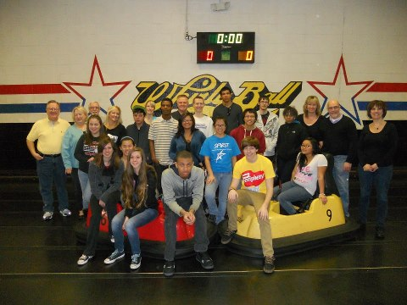
Central Macomb Optimist Club
Asked youth the present their story
Sponsored a Team Building Whirly ball event

Slide 6
Big Families of Michigan
$1000.00 Competitive College Scholarship for Foster Youth
Christmas gifts for foster youth
Back with school supplies
Emergency Packets
Aging Out Suitcase—start up goods

Slide 7
Friends of Foster Care
Collect individualized Christmas wish lists from all foster care youth
Donors from the community shop for specific foster youth and fill their wish list
MYOI members help sort and wrap gifts
Foster care workers deliver the gifts to the foster homes

Slide 8
Lakeside Assembly of God
Big Give Event hosted at the church
Household items, furniture, and appliances
Clothing, cleaning supplies, food distribution

Slide 9
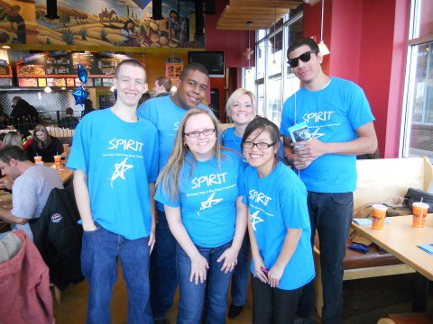
Fundraising
Salsarita Dine to Donate
DHS Staff, Youth Connection, Blue Babies came to support the fundraiser

Slide 10
Bowling Fundraiser
Youth sell bowling tickets
Youth and coordinator secure donations for the raffle from DSH employees and local businesses
Bake sale
Corporate Sponsorship of bowling Lanes

Slide 11
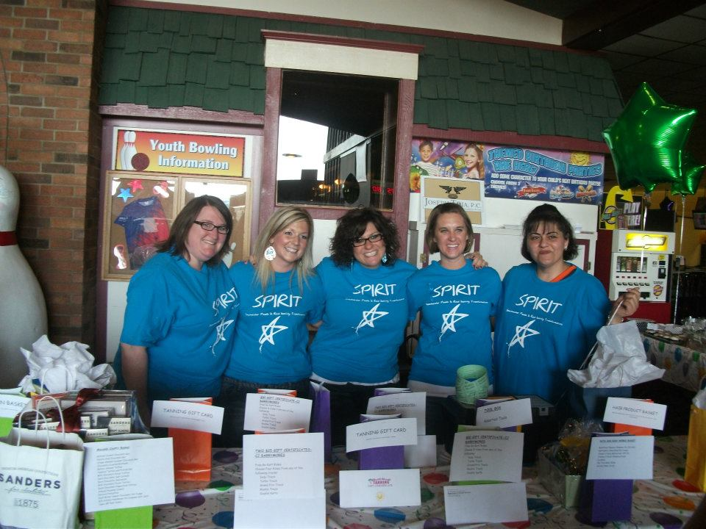
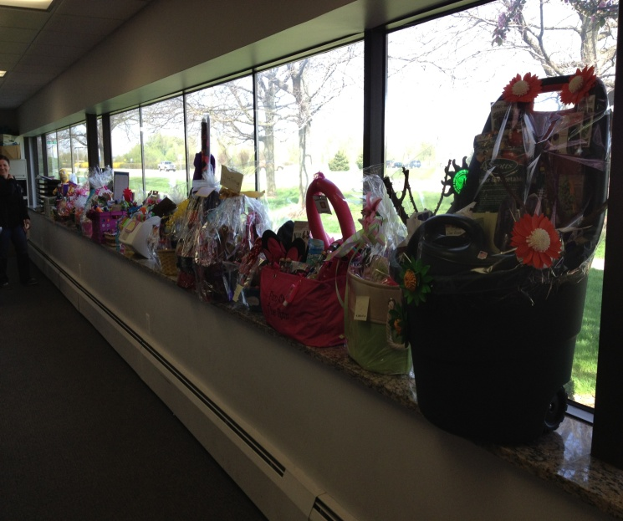
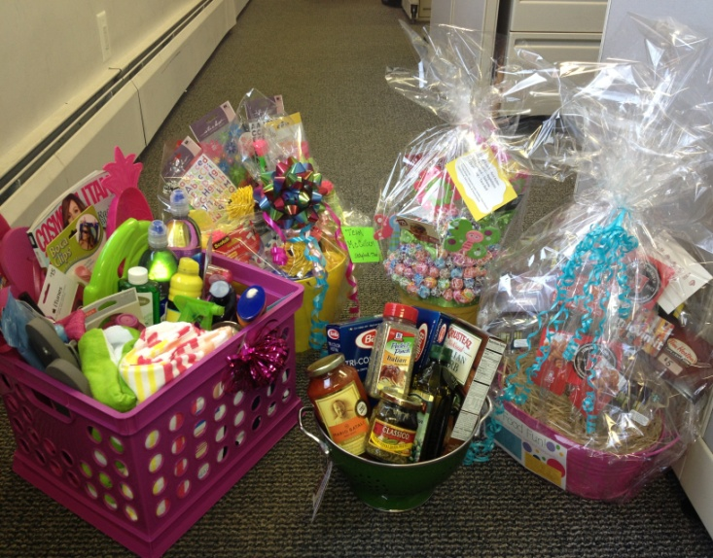
Bowling Pictures

Slide 12
Annual Youth Conference
Exhibitor Tables of community resources—50 plus tables
Motivational Keynote Speaker
Teen specific breakout sessions
Prizes, food, fun

Slide 13
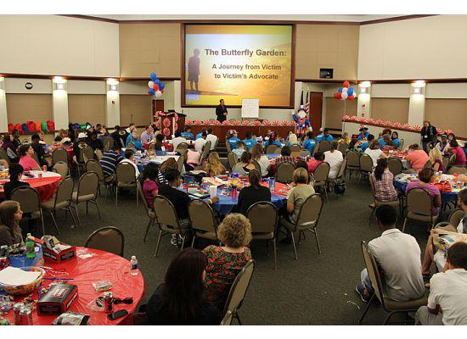
Youth Conference Photos

Slide 14
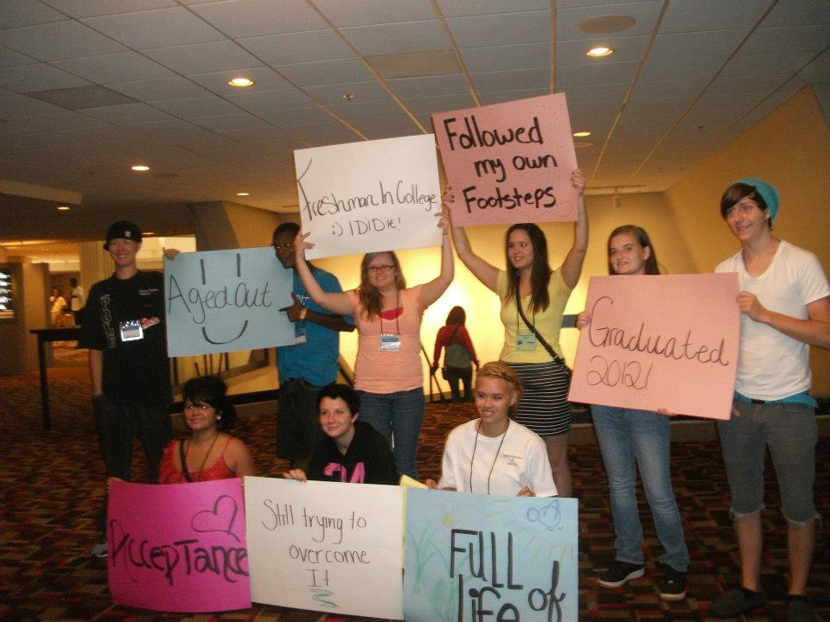
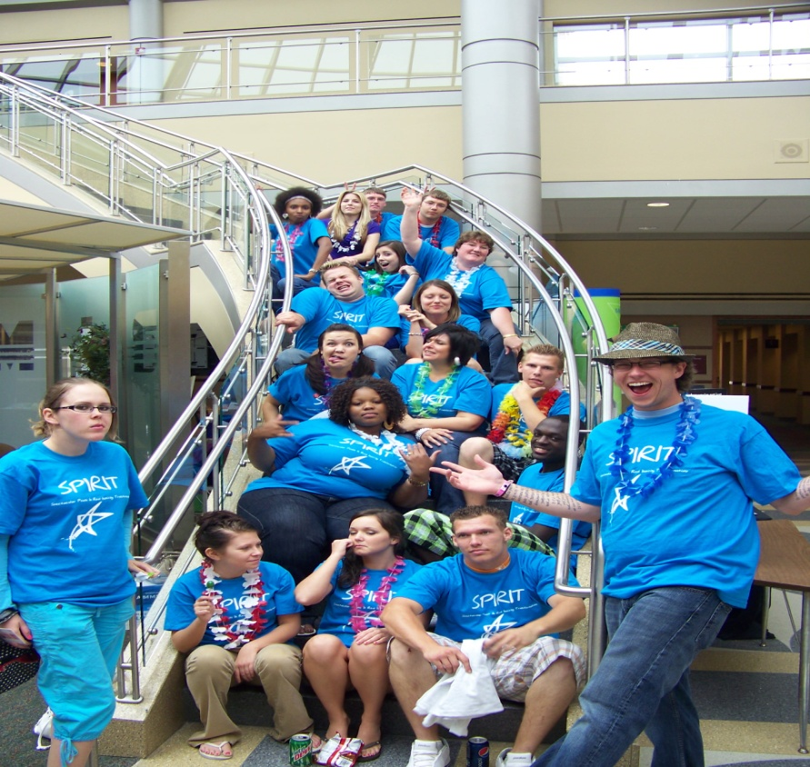
Conference Attendance
Attend Ferris State Take Charge of your Journey and Daniel Memorial Conferences to promote independent living skills

Slide 15
Graduation Hats Off Project
Identify all graduating foster care seniors
Provide a short bio on each youth to community donors through the Volunteer Services Coordinator
Host a dinner and present each graduate with a certificate, present, and meal

Slide 16
Graduation Event Photo

