Slide 1
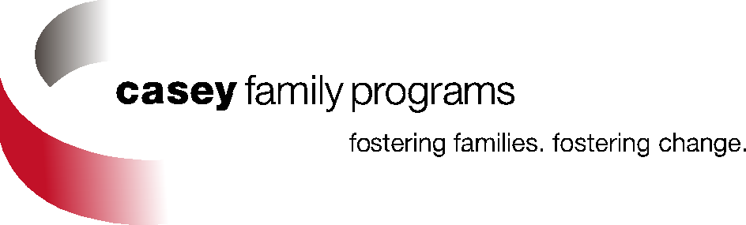
Supporting College Success for Students from Foster Care
Recognizing Advocacy, Practice and Policy Advances!
May 10, 2013

Slide 2
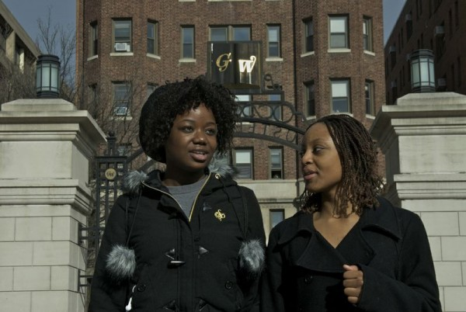
“Graduating from college meant that I won. It proves that my father was wrong when he said I wouldn’t amount to nothing. Most of all, it meant that I would gain the knowledge to use my experience to help other people. College meant freedom from my past and the ability to choose my future.”
Maria, 2007 college graduate from foster care

Slide 3
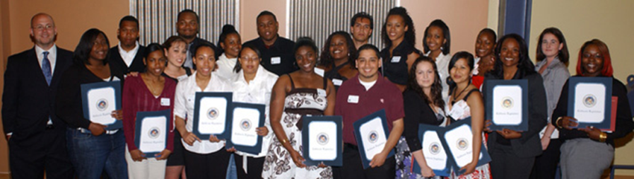
Achieving Improved Higher Education Outcomes for Students from Foster Care by…..
Forming
Collaborative
Partnerships
Spreading
Expanding
Institutional Models & State Systems Approaches
Financial Aid Options
& Packaging Skills
Providing
Promoting
Information, Tools & Strategic Consultation
State & Federal
Policy Initiatives

Slide 4

Policy and Practice ‘Hotspots’ Across the Country
WA
NH
ME
MT
ND
VT
OR
MN
ID
WI
NY
\
MA
SD
MI
WY
RI
IA
PA
CT
NE
OH
NJ
NV
UT
IL
IN
DE
WV
CA
CO
KS
MO
VA
MD
KY
TN
NC
DC
AZ
NM
OK
AR
SC
MS
AL
GA
AK
TX
LA
HI
FL
State Higher Education/Child Welfare Collaborations
High potential to form a collaborative
Some college based support program(s)
State Tuition Waiver Legislation
Unknown
Notes:
Top 10 states for youth in FC
CA, TX, MI, FL, OH,
IL, IN, NY, PA, AZ
34% of all foster youth in the USA (CA, TX, OH, WA, MI, GA, AL) = 34% of all FCY in USA

Slide 5
Achieving Improved Higher Education Outcomes for Students from Foster Care by…..
Forming
Collaborative
Partnerships
Spreading
Expanding
Institutional Models & State Systems Approaches
Financial Aid Options
& Packaging Skills
Providing
Promoting
Information, Tools & Strategic Consultation
State & Federal
Policy Initiatives
Notes:
Exemplars:
Collaborative partnerships (relationships):
At all levels – college, community, state, national
High Education Consortium (slide)
ACC ‘s community advisory team
CCSF w/ Larkin Street Youth Services (Housing, etc.)
CSF, Kresge, Stuart Foundation, YMCA
2. Support models development and spread:
College
State higher ed/CW
3. Information, tools, and TA:
Casey
Program based
FSM
TX Reach
BSU
4. Policy:
State
Federal
5. Financial Aid:
Federal
State
Private/Philanthropic
HEOA:
TRIO & GEAR UP: target and serve students in or aging out of foster care
Staff development activities: strategies for recruiting and serving students from foster care
Definition of independent student: is or was in foster care when 13 years of age or older; was in legal guardianship as determined by court
FAFSA: public awareness campaign; EZ FAFSA; 12 month Pell
Student Support Services: foster an institutional climate supportive of students in or aging out of foster care
Housing
Specifically designed programs
FIPSE: Demonstration projects to provide support services to ensure students who were in foster care until age 18 enroll and succeed in postsecondary education
WA Passport to College Promise
The primary purposes of Passport are to:
Provide former foster youth with financial assistance beyond other state, federal, private, and institutional financial aid for which they are eligible.
Provide incentive funding to postsecondary institutions that designate campus
support staff, and take other steps to recruit and retain former foster youth.
Establish additional student intervention and retention services to foster youth through the College Success Foundation

Slide 6











Higher Education - Advocating for Improved Supports to Students from Foster Care
National Council for
Community and
Education Partnerships

Slide 7

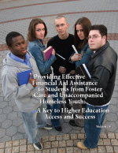

Slide 8
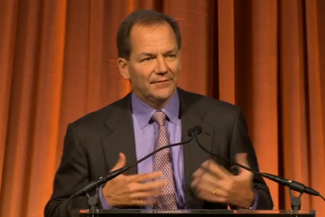
‘The risk is in not doing this work!’
Paul Tudor Jones, Founder of the Robin Hood Foundation

Slide 9
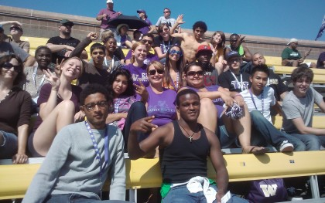
Future Champions Invitational Students - 2012
Let’s do the work – together!

